Slide 1
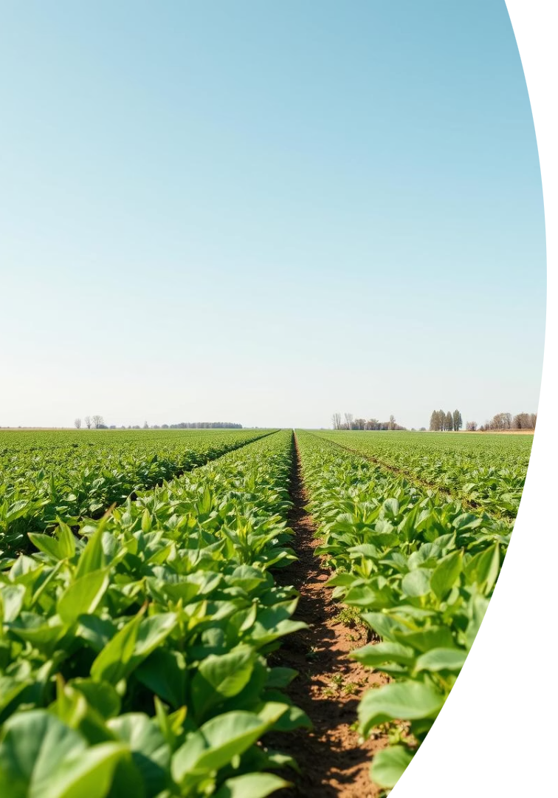
CROP FAILURE PREDICTION Using Bayesian Networks
This project assesses the risk of crop failure by modeling environmental and farming factors with a Bayesian Network. It predicts crop yield levels—Low, Medium, or High—based on rainfall, temperature, soil quality, pest infestation, and fertilizer use. By representing causal relationships in a Directed Acyclic Graph, the model enables probabilistic inference to evaluate scenarios and interventions.
The goal is to provide farmers and policymakers with data-driven insights for better resource allocation and risk management in agriculture.

Slide 2
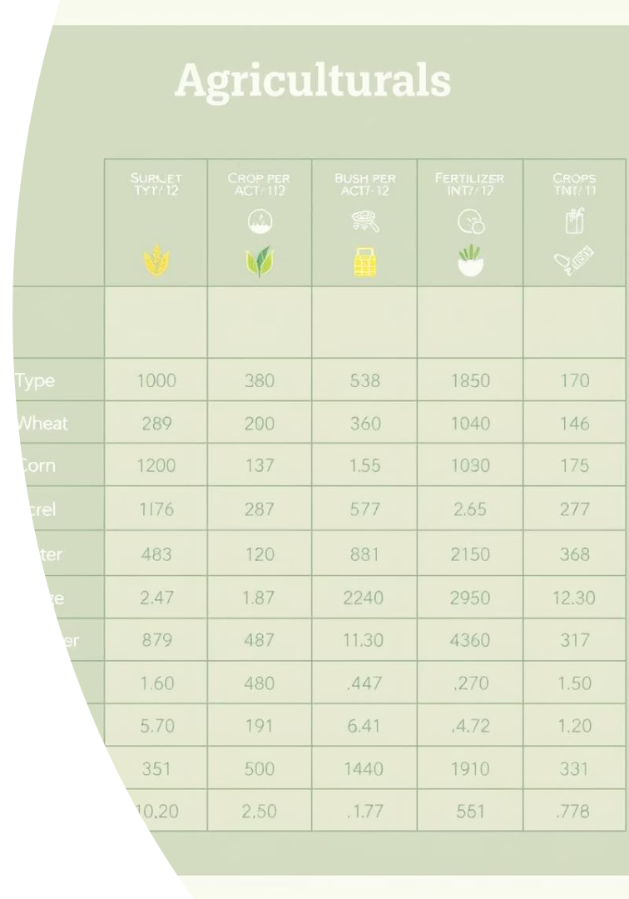
Dataset Overview and Variables
Key Variables
Rainfall: Low, Adequate, Excessive
Soil Quality: Poor, Average, Good
Pest Infestation: True, False
Fertilizer Use: True, False
Temperature: Cool, Mild, Hot
Crop Yield: Low, Medium, High
Data Characteristics
Synthetic dataset simulating environmental and farming factors affecting crop yield in a specific region. Variables are categorical or binary, capturing key influences on agricultural productivity.

Slide 3
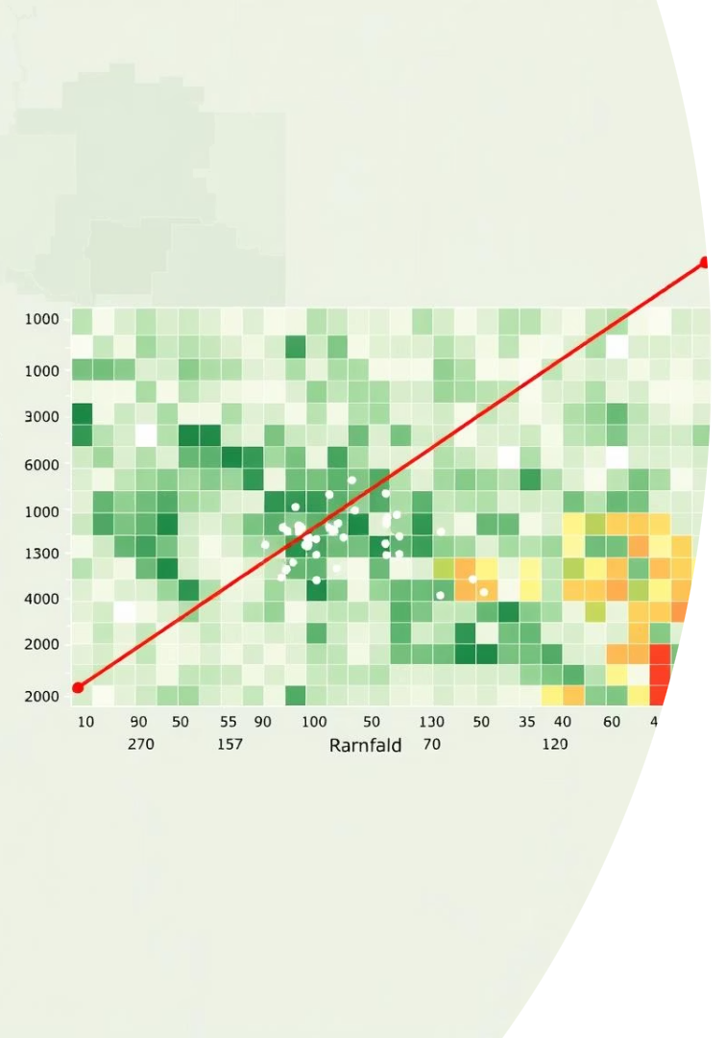
Initial Data Observations
Rainfall Distribution
Soil Quality & Pest Infestation
Evenly split; Adequate rainfall correlates with higher yields.
Poor soil links to low yield; pests more frequent under hot temperatures and poor soil.
Fertilizer & Temperature Effects
Fertilizer use boosts yields, especially with average or poor soil; mild temperatures favor medium to high yields.

Slide 4
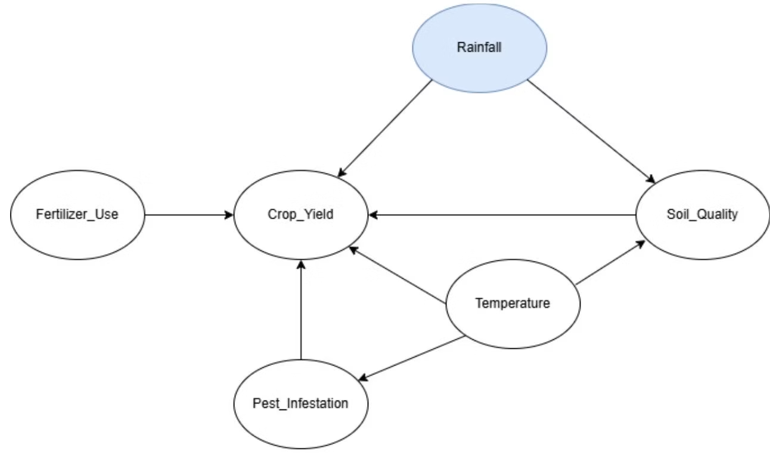
Bayesian Network Structure and Relationships
Key Causal Links
Model Purpose
Rainfall affects Soil Quality and Pest Infestation
The DAG captures dependencies to estimate conditional probabilities, enabling inference on crop yield outcomes under varying environmental and farming conditions.
Temperature influences Pest Infestation and Crop Yield
Soil Quality impacts Fertilizer Use and Crop Yield
Fertilizer Use affects Pest Infestation and Crop Yield
Pest Infestation lowers Crop Yield

Slide 5
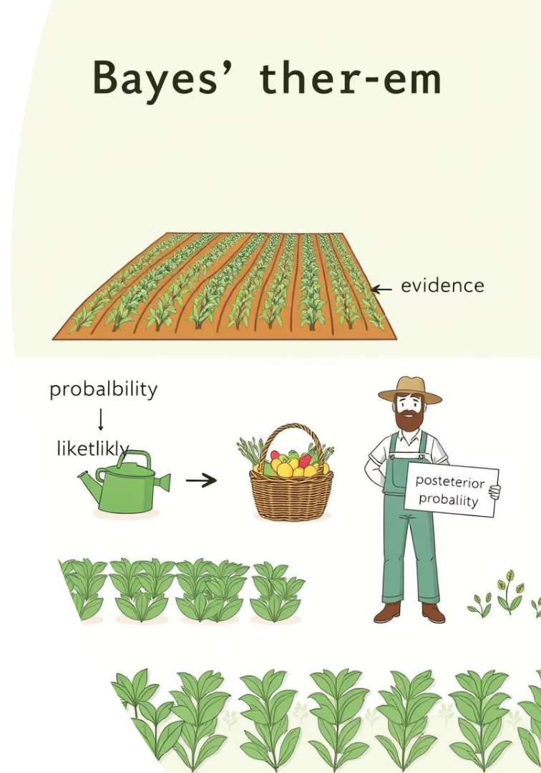

Conditional Probability and Bayes' Theorem

Slide 6
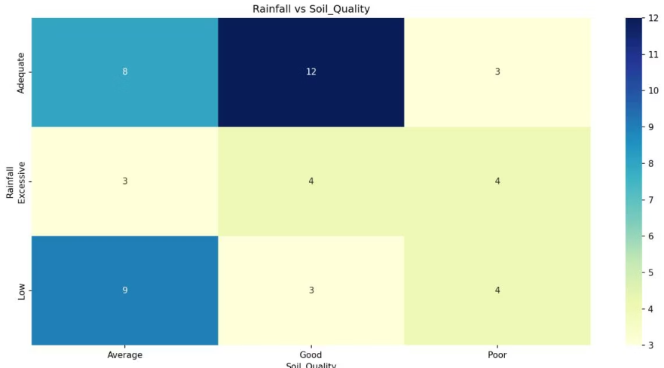
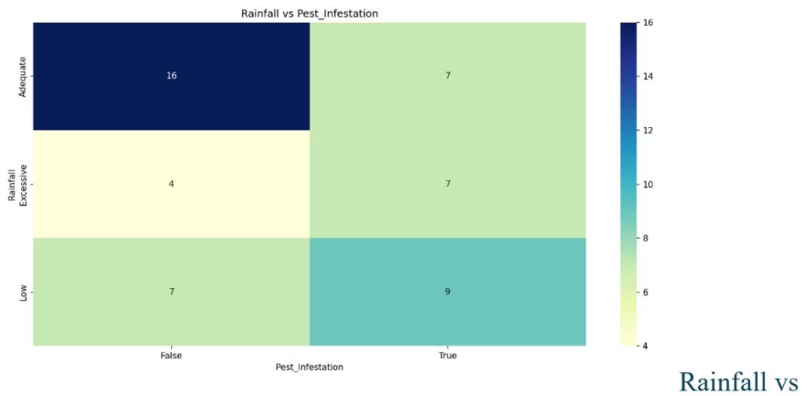
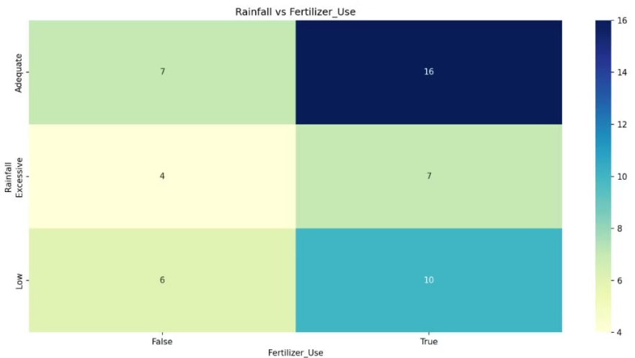
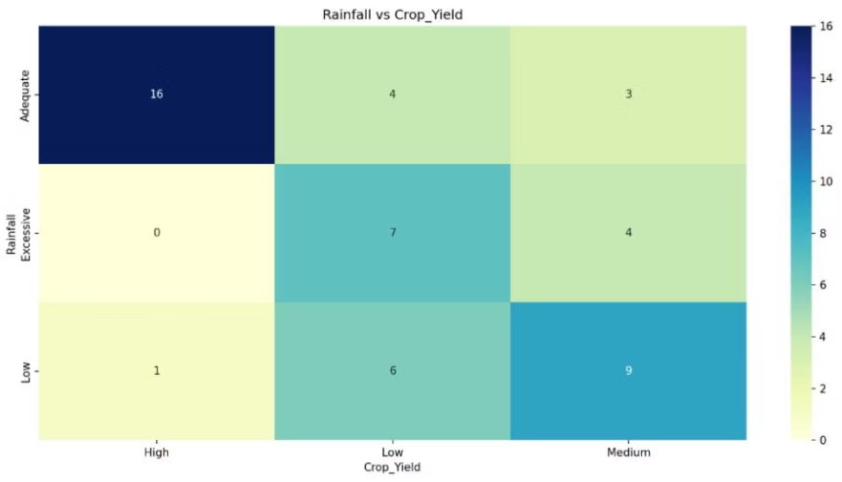
Heatmap Evidence Supporting Causal Links
Pest infestations vary with rainfall, higher under low and excessive rainfall.
Rainfall influences soil fertility and erosion, affecting soil quality distribution.
Fertilizer use patterns depend on rainfall, influencing nutrient application decisions.
High crop yields occur most frequently under adequate rainfall, validating direct relationship.

Slide 7
Discussion, Conclusion, and Future Work
Insights
Limitations & Applications
Future Directions
Rainfall, soil quality, and pest infestation are the most influential factors on crop yield. Fertilizer use improves yield, especially under poor soil conditions.
The synthetic dataset limits real-world generalization. The model offers interpretable predictions for agricultural decision-making and risk mitigation.
Incorporate more extensive real data, add time-series elements, and refine causal relationships to enhance predictive accuracy and applicability.

